Slide 1


Team 7
20193104700 한용준 2020315118 강민규 2020311661 전민규
담당 교수: 이준원 담당 조교: KHANOSAMA 김영현 이현수

Slide 2





Contents
Introduction
Code Structure
Demo
Student’s role
Topic
Player 1
Goal
Player 2

Slide 3

Introduction

Slide 4


Speed Game: Call of Animal
랜덤으로 화면에 나오는 동물 사진을 보고 동물의 이름을 상대보다 먼저 입력
플레이어가 설정한 라운드 수 만큼 게임 판 수 진행
각 라운드마다 시간제한 안에 두 플레이어가 답을 내지 못하면 무승부로 결정
정답을 맞추거나 무승부시, 해당 동물의 울음소리를 들려주며 채팅 화면에 답을 알려줌

Slide 5

ROUND 1
TIME: 30sec
Rabbit
PLAYER 1
PLAYER 2

Slide 6
ROUND
…..(울음소리)
Player 1 WIN!
PLAYER 1
PLAYER 2

Slide 7
NO ANSWER SUBMIT IN 30 SEC
…..(울음소리)
DRAW
PLAYER 1
PLAYER 2

Slide 8

Goal
간접적인 동물의 모습과 울음소리 체험
영어학습과 순발력 향상

Slide 9
Code Structure

Slide 10
Code Structure
Main (JFrame)
Title (JPanel)
Back:
Answer (JPanel)
GameScreen (JPanel)
Setting (JPanel)
Back:
Animal
Game (JPanel)
RAndom
Result (JPanel)

Slide 11
Main
Game Start
2 Options
: can make server(game room) or connect to server
Answer
:can see the samples for each round

Slide 12
GameScreen
Setting
: manages server(connection with other player)
Result
: decide the winner and loser
Game
: manages time count per round, score for each player, round, answer submission

Slide 13
GameScreen
Server
Run
Socket을 이용한 서버 생성, multi thread로 relay messages 구현
Client
RelayMessages
Player들에게 게임간 메시지 전송
Timer
Answer

Slide 14
For: Settings
GameScreen
Corresponding Panel: Setting
Create simple client host socket with additional
checkIp(serverIp); checkName(name);
Values.
Allocates each socket instance as a thread

Slide 15
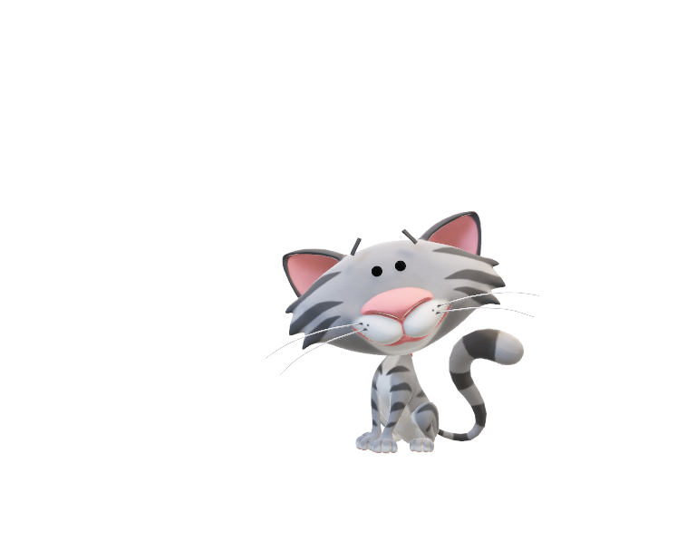
Additional Functions:
Host settings:
‘Create Room’: create a room for local IP (does not apply for different DNS setup)
‘Port Number’: set a socket port to the number given
‘Your’s Name’: name for host
‘Create!’: sends client to quiz screen
Client settings:
‘Join Room’: join a room for local IP (must know room host’s IP)
‘Server’s IP’ : connect to given IP
‘Port Number’: connect to given port
‘Your’s Name’: name for client
‘Access!’: sends client to quiz screen upon success
For: Settings

Slide 16
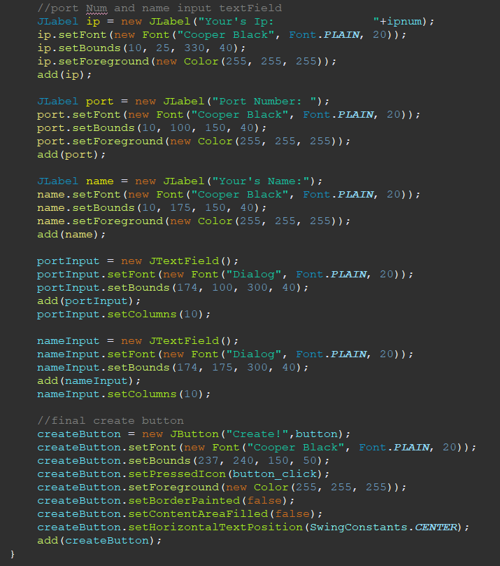
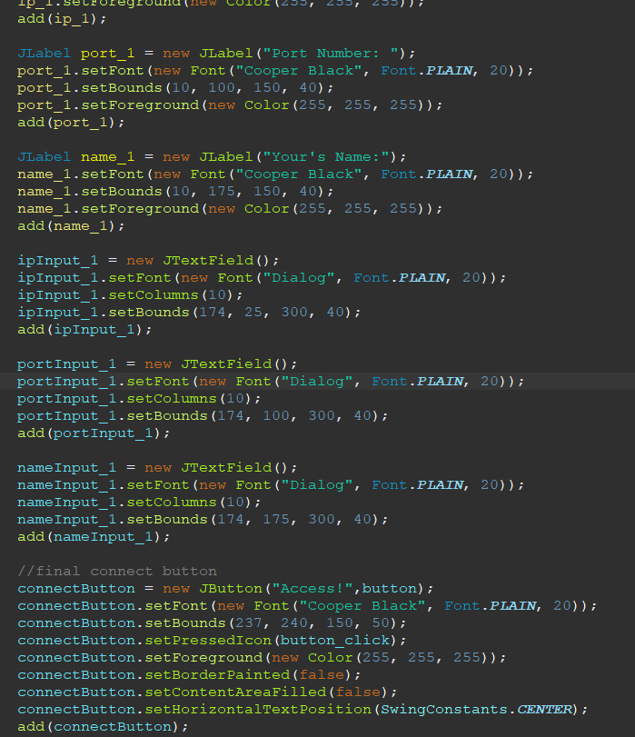

Slide 17
For: Game Rounds
GameScreen
Corresponding Panel: Game
Show simple chatbox JLabel for Clients
Answers by clients are displayed in the chatbox
Quiz Answer when 1. a client guesses
the correct animal name 2. timer runs out
are displayed in the chatting box

Slide 18
For: Game Rounds
Additional Functions:
‘Game Start’: when both clients are connected, start the quiz
‘Next’: go to next round
‘Submit’: alternative to pressing enter. Answers must be submitted by clicking this button

Slide 19
For: Game Results
GameScreen
Corresponding Panel: Result
Shows 3 screens based on Round Scores:
You Win (Score is higher than other client)
2) You Lose… (Score is lower than other client)
3) You Draw (Score is equal to other client, only happens when total rounds are even)
Additional Functions:
‘Quit’: when all rounds are played, exit the program

Slide 20
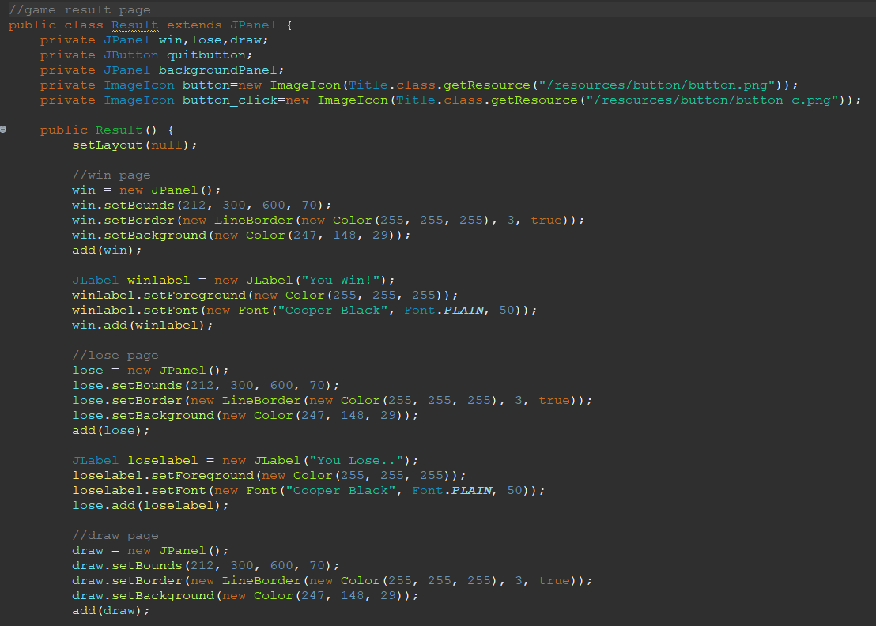
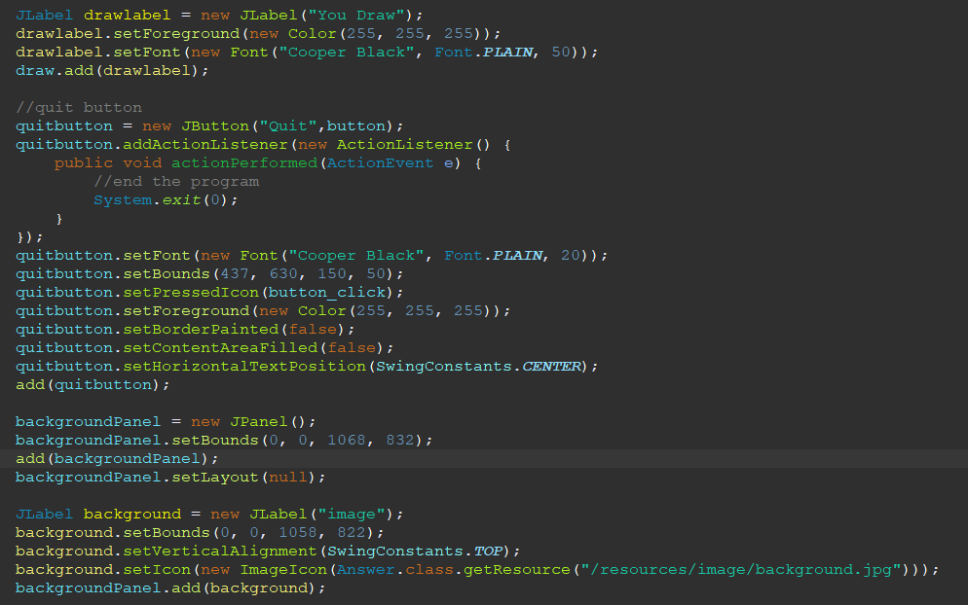

Slide 21
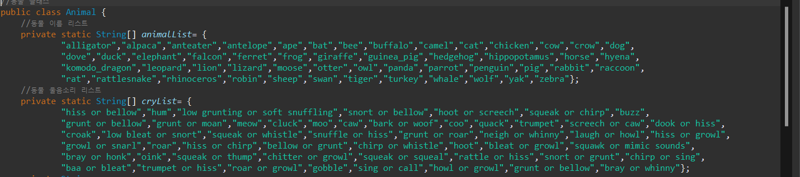
Answer
Get sample examples from animalList, cryList show the player.
Additional Functions:
‘next’: show next example
‘before’: return to example just showed before
‘back’: go back to main screen
‘sound’: show player sound of animals

Slide 22
Demo

Slide 23
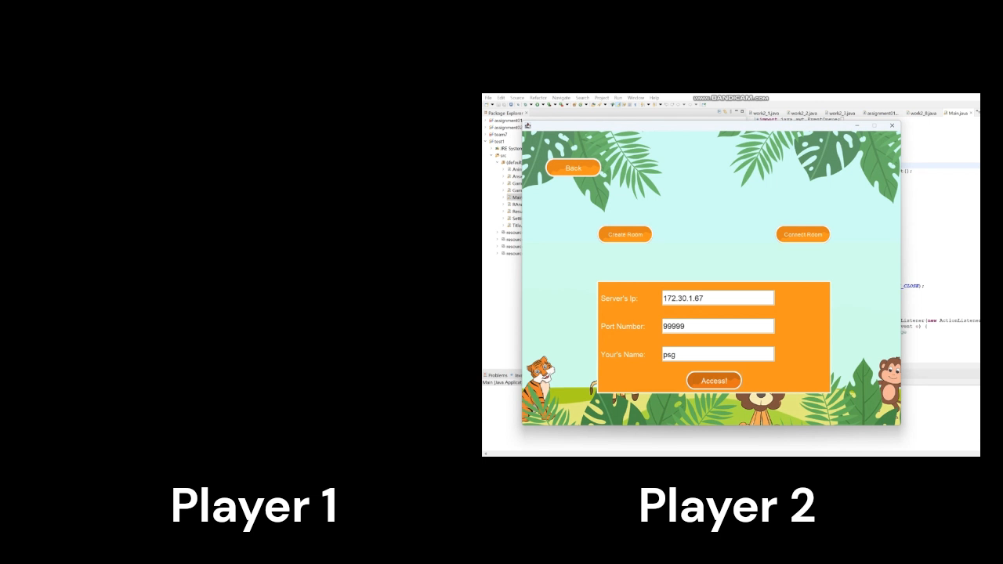
Demo

Slide 24
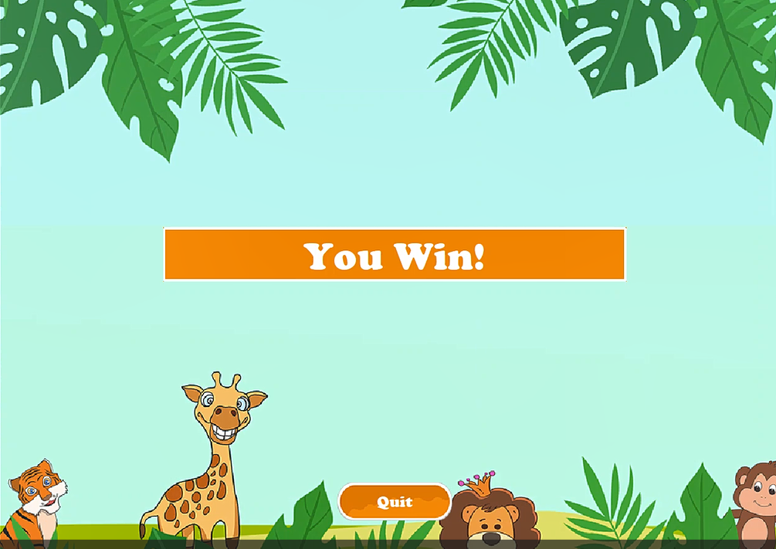
Screen for winner

Slide 25
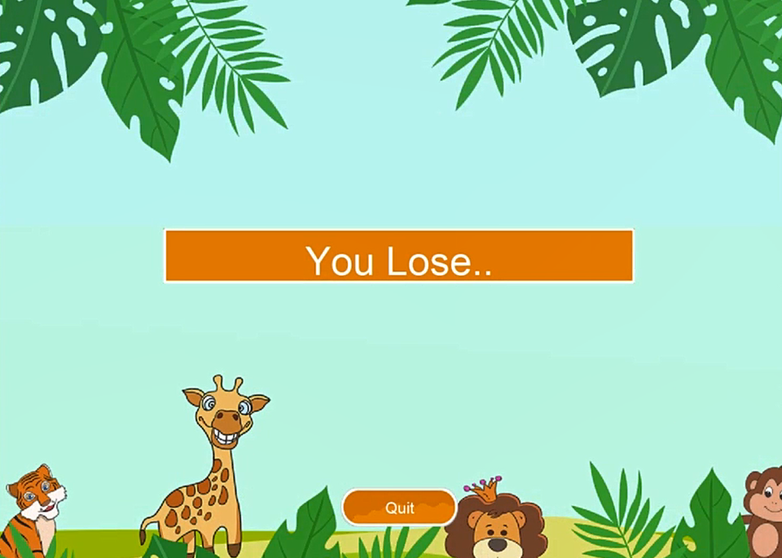
Screen for loser

Slide 26
Student’s Role

Slide 27
7 팀 : CallofAnimal
20193104700 한용준
Gui 구현
ppt,영상제작
Timer, Gamescreen클래스 초안
2020315118 강민규
Gamescreen 서브 클래스 초안( Setting, Host, Client)
소켓 프레임워크
테스팅 및 디버깅
Class Diagram 수정
Ppt 수정
2020311661 전민규
리소스 수집, 가공
전체적인 Gui 구현 및 조율(Title, Answer, Gamescreen panel 등)
Aniaml, RAndom 클래스 초안

